Slide 1
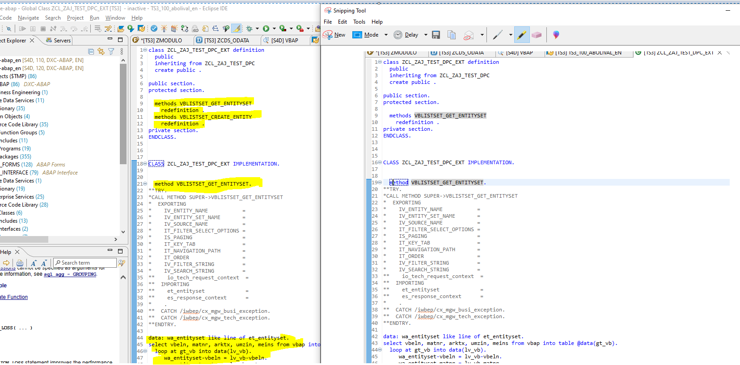

Slide 2
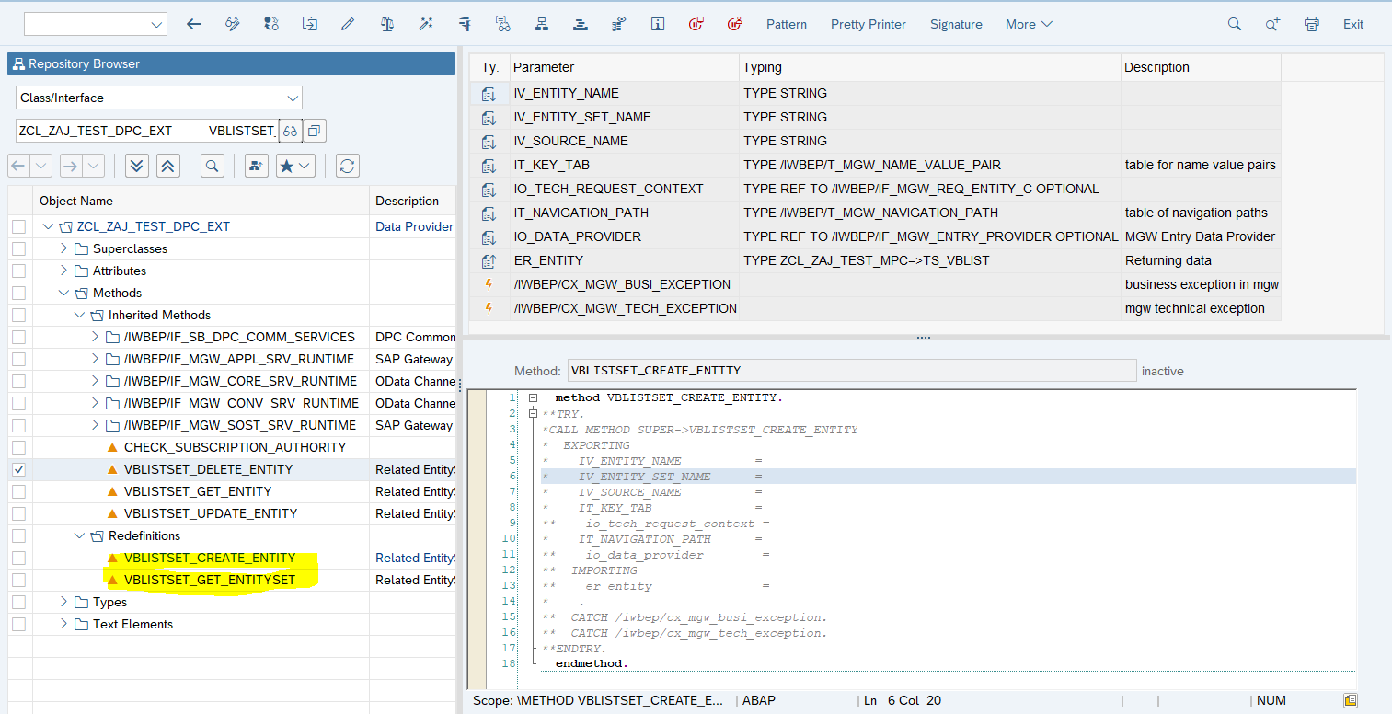
Can see the method name inside the class method. Note: do not change the method name in the program

Slide 3
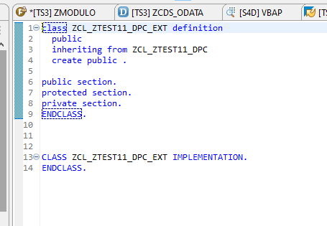
If empty

